Slide 1
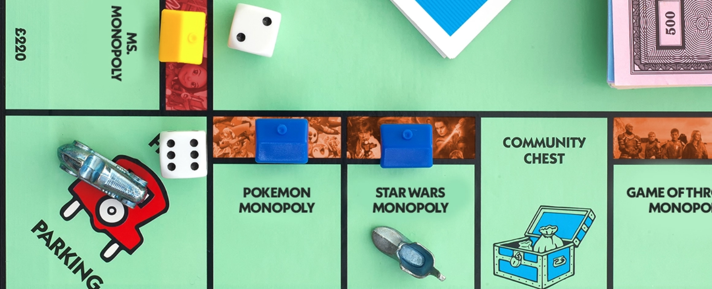
Understanding
Monopoly

Slide 2
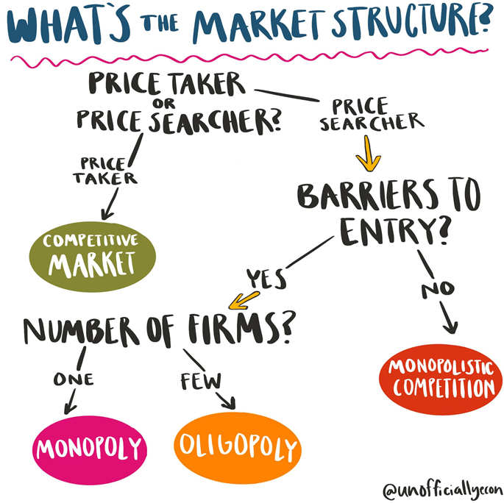

Slide 3

Monopolies
in the news

Slide 4
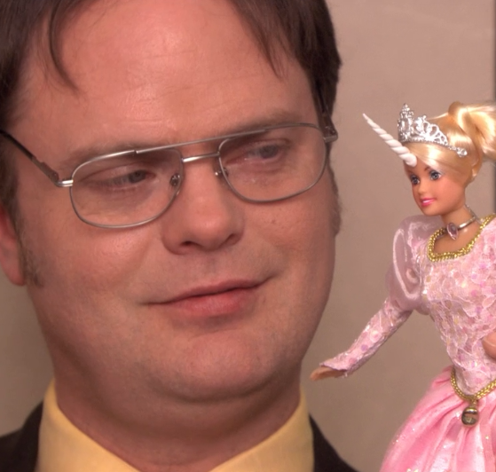
Monopoly
are costs that have been paid as a result of past decisions.
A monopoly has three main characteristics:
produces in a market with high barriers to entry
many buyers but only one seller
a unique product with no good substitutes

Slide 5
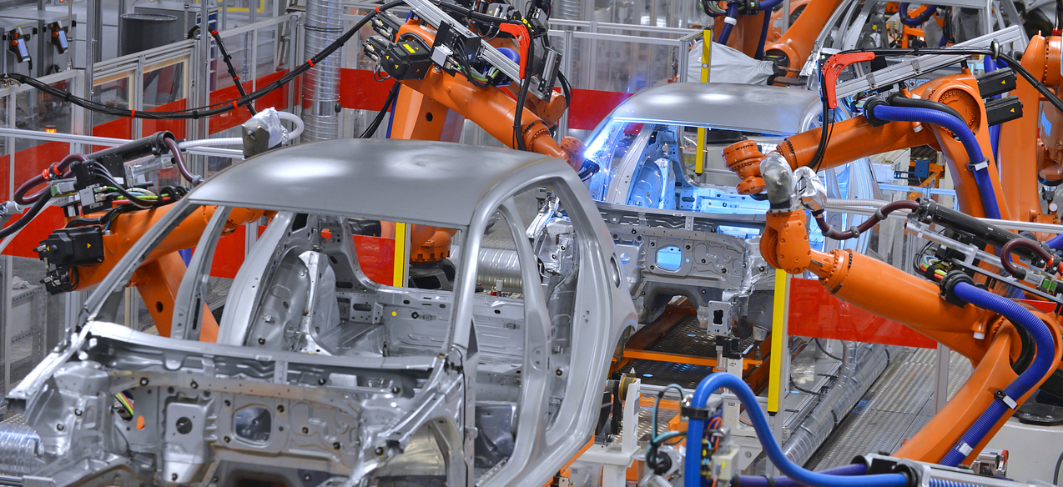

Which do you think can be done at an overall lower cost?
100 car manufacturers producing 10 cars each
2 car manufacturers producing 500 cars each

Slide 6

High Barriers
to Entry
A natural monopoly occurs when a single large firm has lower costs than any
potential competitor.

Slide 7
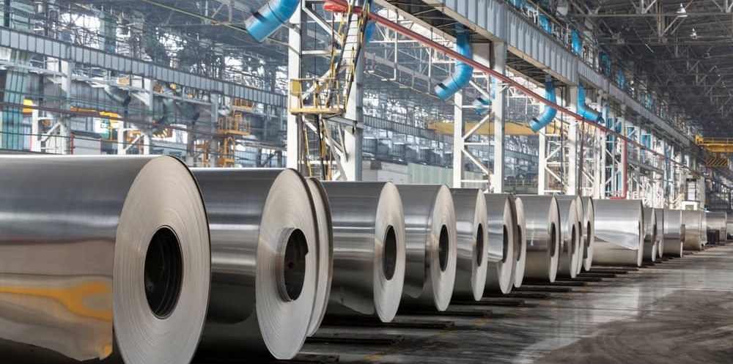
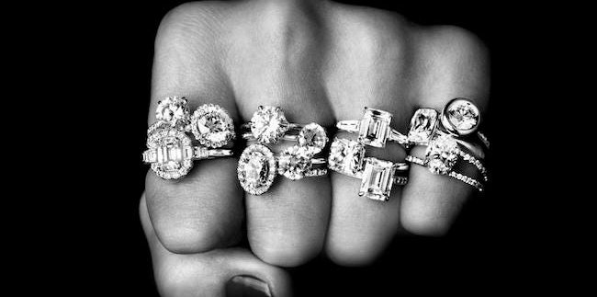
High Barriers to Entry
Control over an essential resource
In the early 1900’s, ALCOA owned 90% of the world’s bauxite.
De Beers owns nearly 70% of the world’s diamond mines.

Slide 8

High Barriers
to Entry
Raising enough capital:
Lenders are not likely to loan you $10+ million to start a business. You need a big loan to compete with an established monopoly that has already has a huge amount of capital and equipment invested.

Slide 9



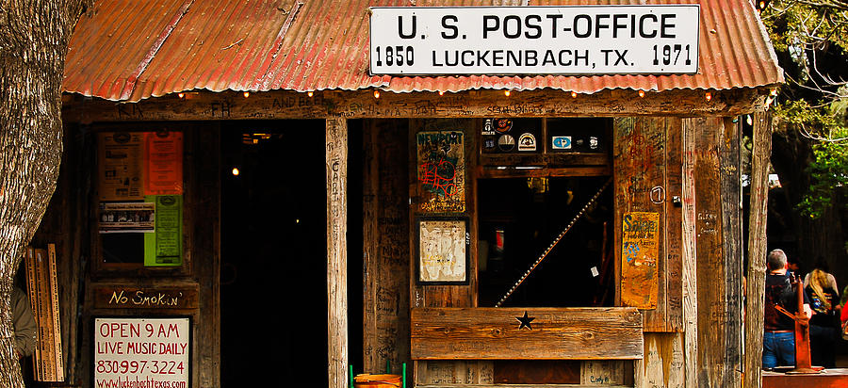
High Barriers to Entry
Government restrictions
Paul Tran

Slide 10
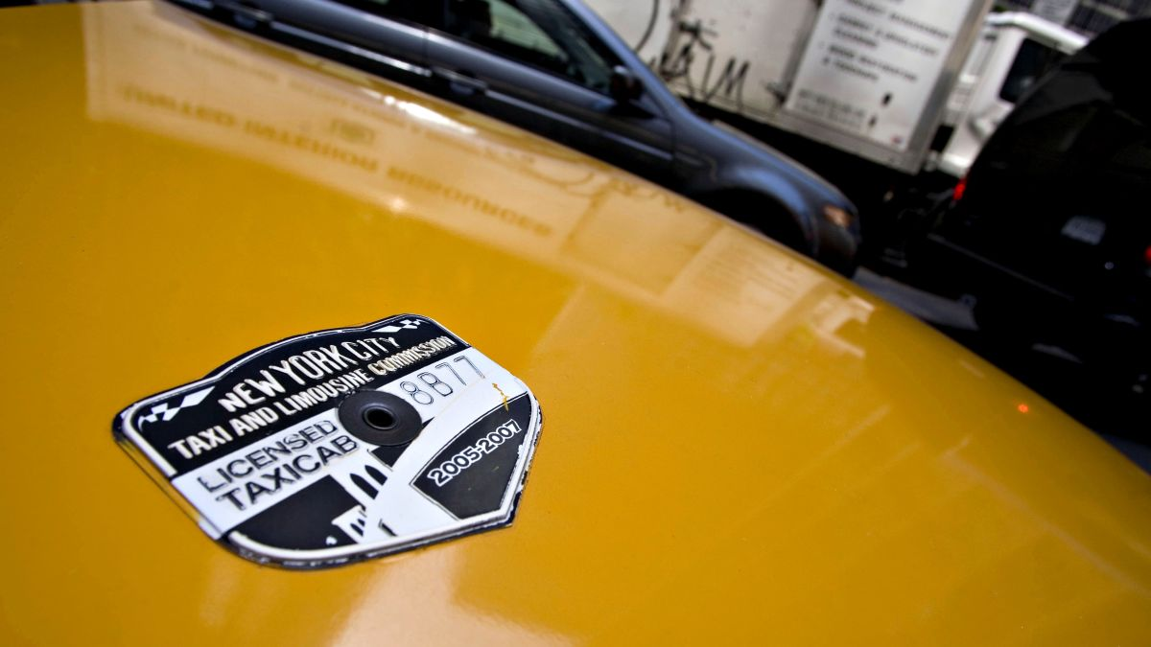
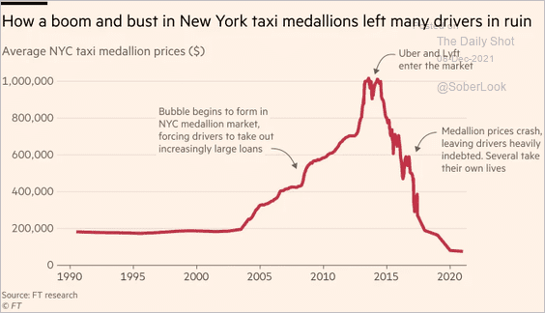
From the Great Depression until 1996, New York City kept the number of taxicab licenses (called “medallions”) fixed at 12,787.
In 2010, medallions were worth over $1M! Today, medallion prices are less than $100,000 – the result of 100,000 ride-share drivers competing with taxis.

Slide 11


Demand Curve for the Monopolist
Demand Curve for the Perfect Competitor
Price Maker
Price Taker
Price per Unit
Price per Unit
d
D
Q
Q
Pure monopoly exists when
one firm is the industry.
Perfect competition exists when
one firm’s output is irrelevant.

Slide 12
Price | Quantity | TR | MR
$5.50 | 0
$4.50 | 1
$3.50 | 2
$2.50 | 3
$1.50 | 4
TR | MR
(P x Q) | (Δ TR)
$0 | $0
$4.50 | $4.50
$7.00 | $2.50
$7.50 | $0.50
$6.00 | ($1.50)

Slide 13
Marginal Revenue of a Price Maker
Price
The “price” effect
What happens to MR when the firm lowers the price?
Answer: The firms must consider the gains in revenue from additional sales (the “output” effect) versus the losses in revenue (the “price” effect).
The “output” effect
P₁
P₂
D
MR
q₁
q₂
Quantity

Slide 14
Monopoly Profit
Price
MC
Firms maximize profits by producing where MR = MC
ATC
P
profit
ATC
Along the dashed line at q, D is above ATC. Therefore, the firm makes the profit in the green rectangle.
MR = MC
D
MR
q
Quantity

Slide 15
TPS: H&R Block has estimated the demand and
marginal revenue for tax preparation services.
P = 100 - 5Q and MR = 20 - 2Q
The MC of preparing a client’s taxes is 4.

Slide 16
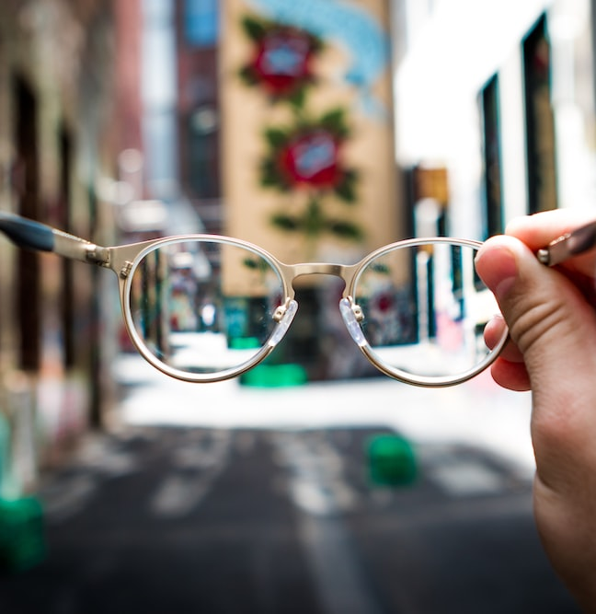
Defects
of Monopoly
A reduction in the competitiveness of a market limits the options available to consumers.

Slide 17

Defects
of Monopoly
The signaling mechanism, which would ordinarily encourage competition and eliminate excessive profits, is broken since the monopolist enjoys high barriers to entry

Slide 18

Defects
of Monopoly
Prices are higher and output is lower than
under perfect competition.

Slide 19
Prices are higher and output is lower than under perfect competition.
The Defects of Monopoly
S = MC
S = MC
Price per Unit
d = MR
D
MR
q
q
Pure Competition
Monopoly

Slide 20

Defects
of Monopoly
Firm often engage in rent seeking, which is an unhealthy comptetition to become a monopolist.

Slide 21

Adam Ruins Rent Seeking

Slide 22

TPS: Your chance to rent seek
This is your chance to earn 10 points. I will award the 10 points to the highest bidder. The only difference between this auction and a standard sealed bid auction is that ALL BIDS must be paid. This includes losing bids in addition to the winning bid.
For instance, if the winning bid is 3 points, then the winner earns 10-3 or 7 participation points. If the second highest bid is 2 points, those points are deducted from your class total, etc…

Slide 23

Solutions
to Monopoly
1. Break up the monopoly
2. Reduce barriers to entry
3. Regulate the market
4. Do nothing

Slide 24
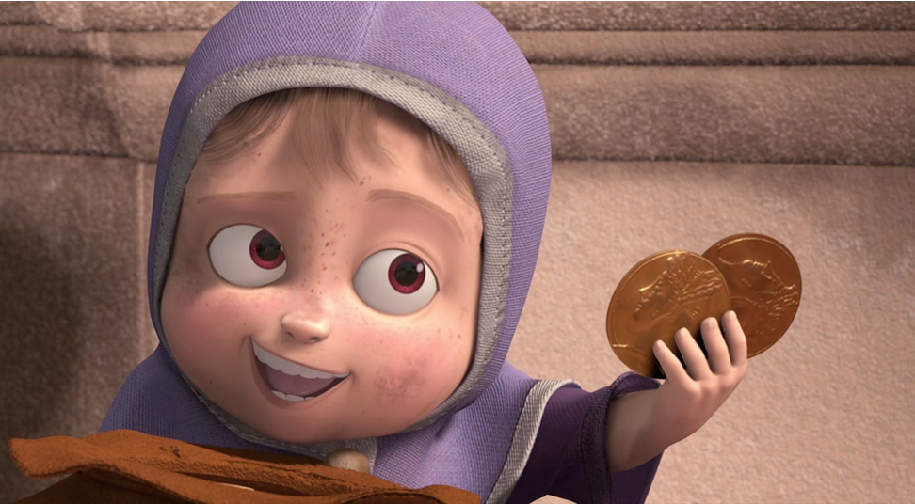
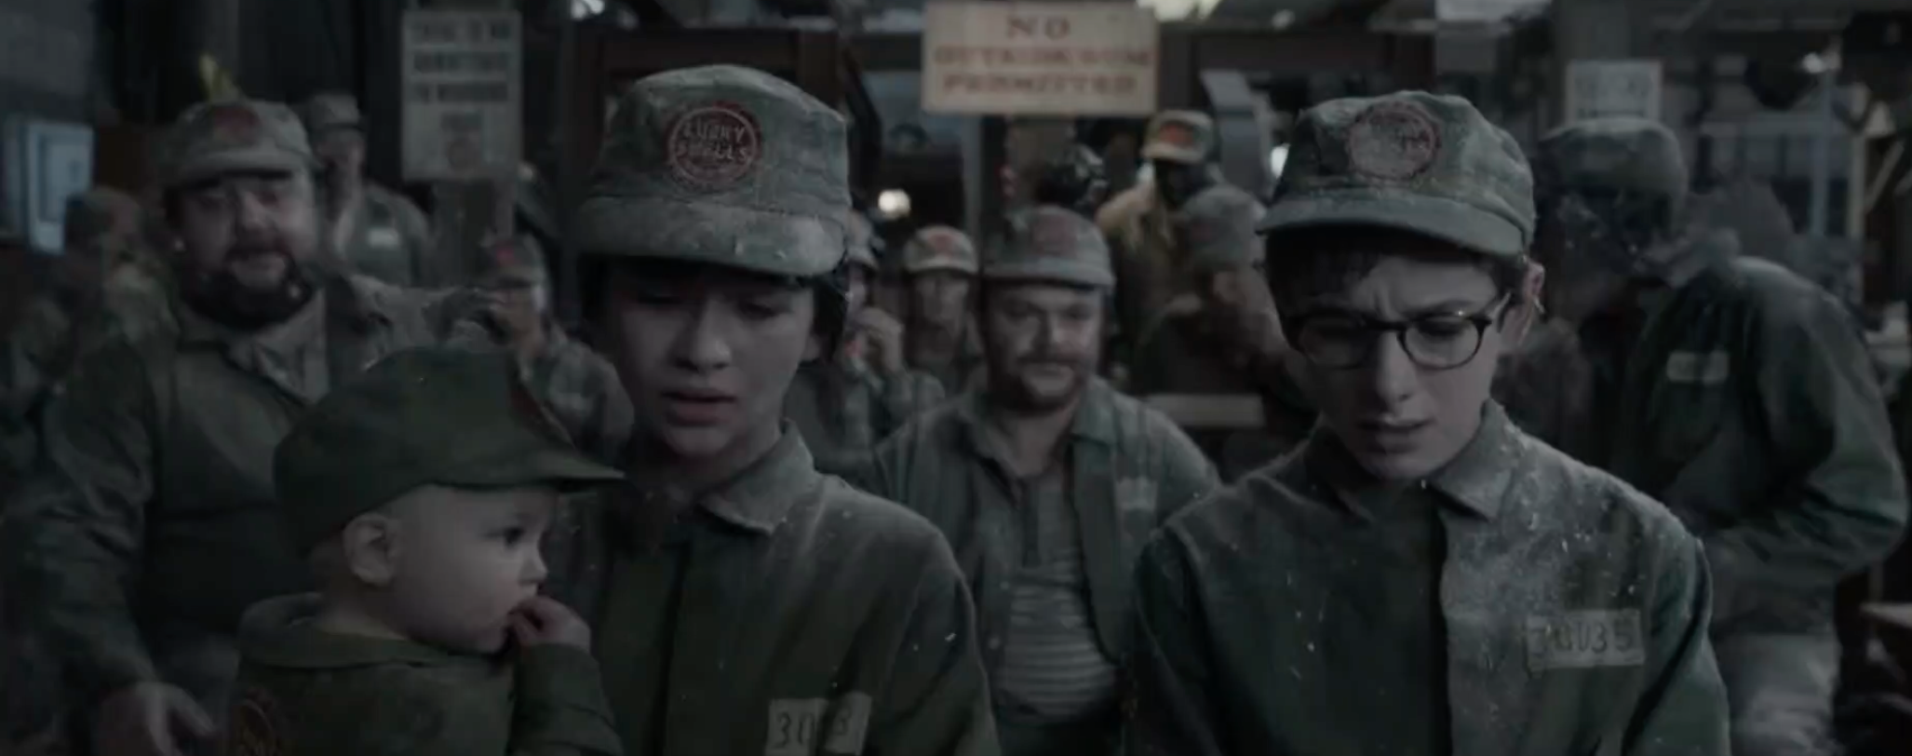
Monopsony
A market with only one buyer
Ex: a town with only one employer

